Slide 1

WEB PROGRAMMING PROJECT:
By: ERIC YOUNGOUA
ZENGANG FRANCK
WELCOME IN CAMEROON

Slide 2
TABLE OF CONTENTS
Introduction
Used langages
Discover
Tasks répartition
Futures updates
Conclusion

Slide 3
INTRODUCTION
During this project, we tried to bring more attention to our country Cameroon and some personalities that made it famous through their various achievements.
We used our knowledge in web programming in general, and more specifically in HTML,CSS and JAVASCRIPT.
In the following slides we are going to present our work.

Slide 4
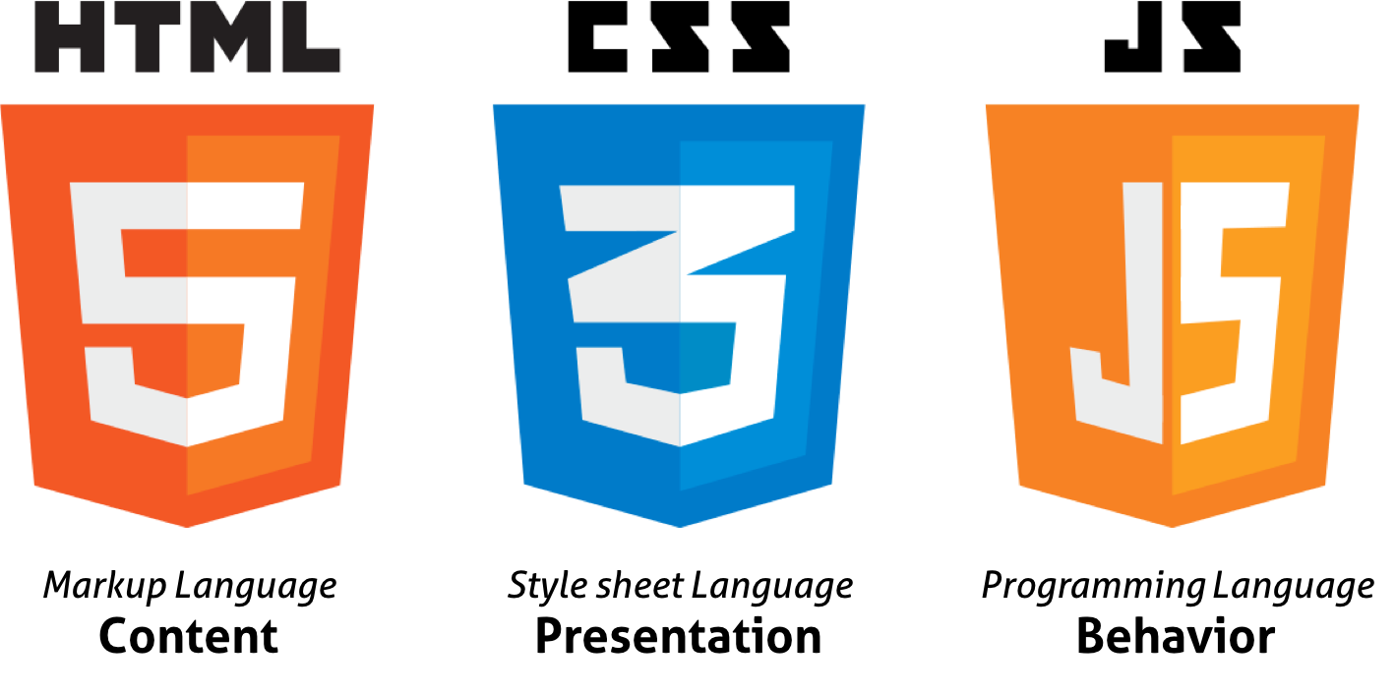
USED LANGAGES
We used the third principal languages of web design to realize this project. Of course, I mean HTML, CSS and JavaScript.
HTML was used to create the elements of the page, to create the basic structure of our project as sentences, images, buttons, etc…
CSS was used to make the project more beautiful, it allows us to add color, paddings, margins, responsivity and it manage all the design aspect of our work.
JavaScript was used to add interactivity at our job and define the action after submitting the form.

Slide 5
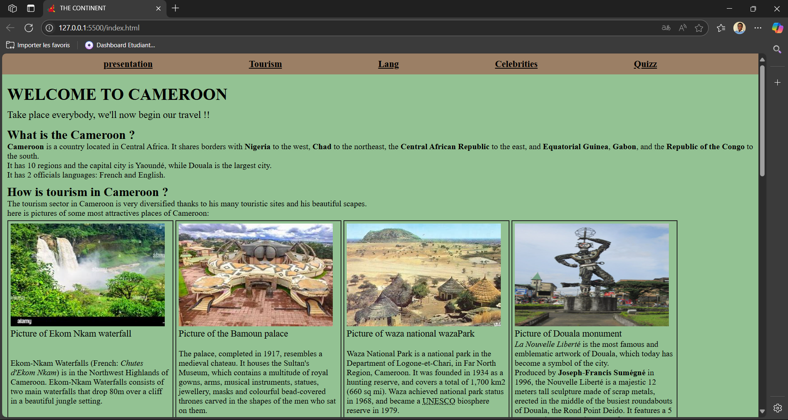
Discover

Slide 6
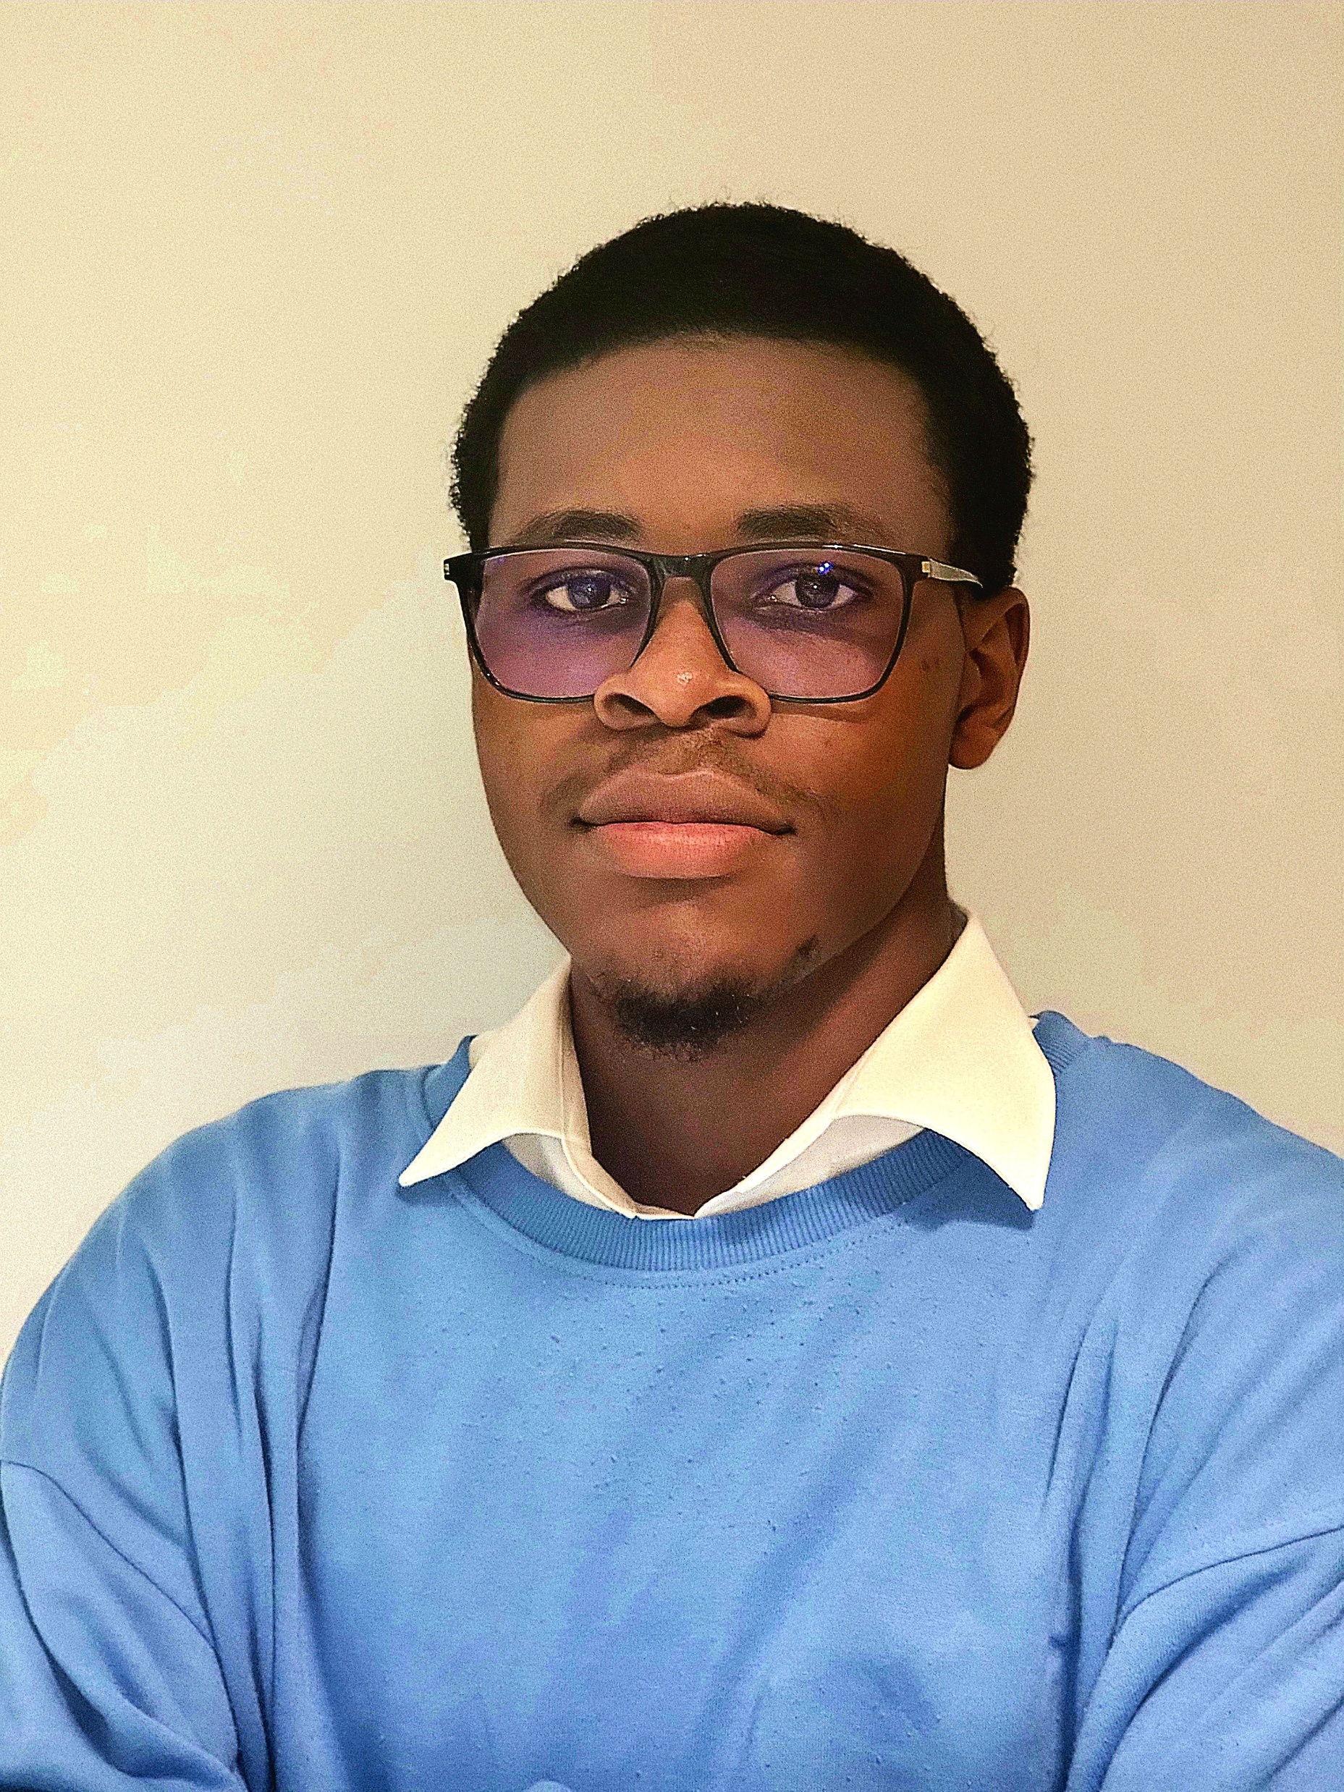
TASK REPARTITION
Marcel ERIC YOUNGOUA TCHONGOUE
Tasks:
Create the html structure
Design the website
Manage the accessibility of the website
Impressions:
It was very hard to design the website, especially the accessibility part, regarding HTML, the most difficult was understand how and where make it accessible.

Slide 7
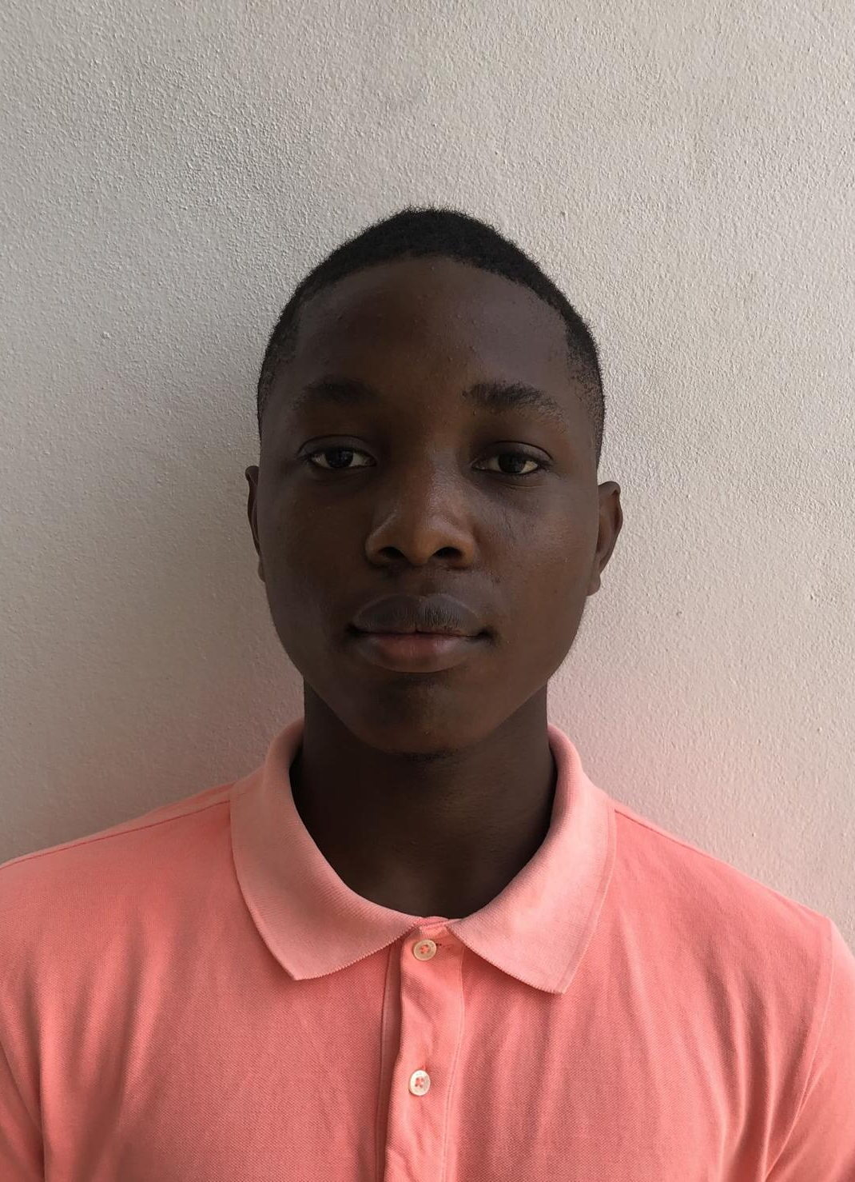
TASK REPARTITION
Franck-Laurel ZENGANG NGAPMEN
Tasks:
Manage the JavaScript part
Make research about the content of the site
Product the report
Impressions:
For my own, the hardest thing was to implement the JavaScript code, as much to understand the language than to use it.

Slide 8
Futures updates
Upgrade the responsivity of the code
Hone the accessibility
Add others sections and more questions
Separate the Quizz’s part of the rest of the page
Add more interactive elements and use them more wisely
Add a database and host the site
Use AI to purpose a destination based on the preferences of the user

Slide 9
Conclusion
This topic was choosed to particularly to showcase the combination of our abilities in HTML,CSS and JAVASCRIPT wiyh our pride of being from Cameroon.through the processs of making this project we faced challenges that helped us make further researches which were benfic because we acquired more knowledge.
We enjoyed making this project together because it was quite fun and interessing because we made further steps towards our ultimate academic goal which is to be fully competent engineers in the computer sector.

